Slide 1
Building Balanced Search Tree based on Layered Decision Tree for Packet Classification
Author: Yeim-Kuan Chang, Chao-Yen Chien
Presenter: Chih-Hsun Wang
Date: 2015/12/30
Department of Computer Science and Information Engineering
National Cheng Kung University, Taiwan R.O.C.
Notes:
1

Slide 2
Introduction
  We propose a scheme called Layer based Search Tree (LST) to solve multi-field packet classification problem.
  LST search engine with dual ported memory can sustain the throughput of over 120 Gbps for the packets of minimum size (40 bytes).
Notes:
近期因為ruleset size快速成長，因此ruleset複雜度造成一般封包分類方法memory表現很差
Swintop是一種將ruleset去分類的方式

Slide 3
Proposed Scheme
There are four groups in the proposed scheme：
We select either group 2 or group 3 that has more rules than the other to merge with group 1.
 | Source address field | Destination address field
Group 1 | Non-Wildcard | Non-Wildcard
Group 2 | Wildcard | Non-Wildcard
Group 3 | Non-Wildcard | Wildcard
Group 4 | Wildcard | Wildcard
Notes:
近期因為ruleset size快速成長，因此ruleset複雜度造成一般封包分類方法memory表現很差
Swintop是一種將ruleset去分類的方式

Slide 4
Proposed Scheme
A binary decision tree is used to divide the rules into several buckets.
Basically, the proposed decision tree is constructed based on Hicuts. We select the field denoted by field(v) such that the resulting number of rule duplications is the least compared to cutting the node along any other fields.
Notes:
近期因為ruleset size快速成長，因此ruleset複雜度造成一般封包分類方法memory表現很差
Swintop是一種將ruleset去分類的方式

Slide 5
Proposed Scheme
Attributes of each node v :
sp(P₁ [v],…, P_{d} [v]): the address space covered by node v
rule(v): the set of rules that intersect sp(P1 [v],…, Pd [v]).
field(v): the selected field to cut the address space of v.
Notes:
1. d is the number of fields of the rules. The root node covers the entire d-dimensional address space.

Slide 6
Proposed Scheme
right(v)/left(v): the right and left child pointers of v.
LF(v): the layer to which node v belongs
L(v): the set of labels from the first layer to LF(v).
Notes:
1. d is the number of fields of the rules. The root node covers the entire d-dimensional address space.

Slide 7
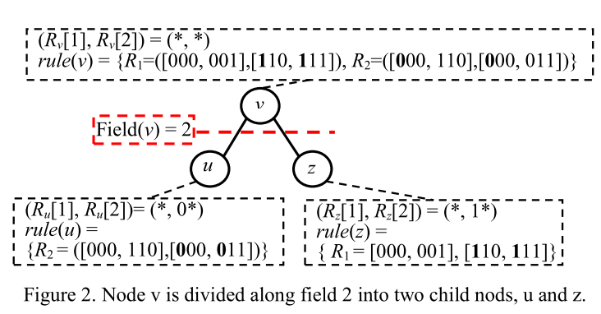
Proposed Scheme
Notes:
近期

Slide 8
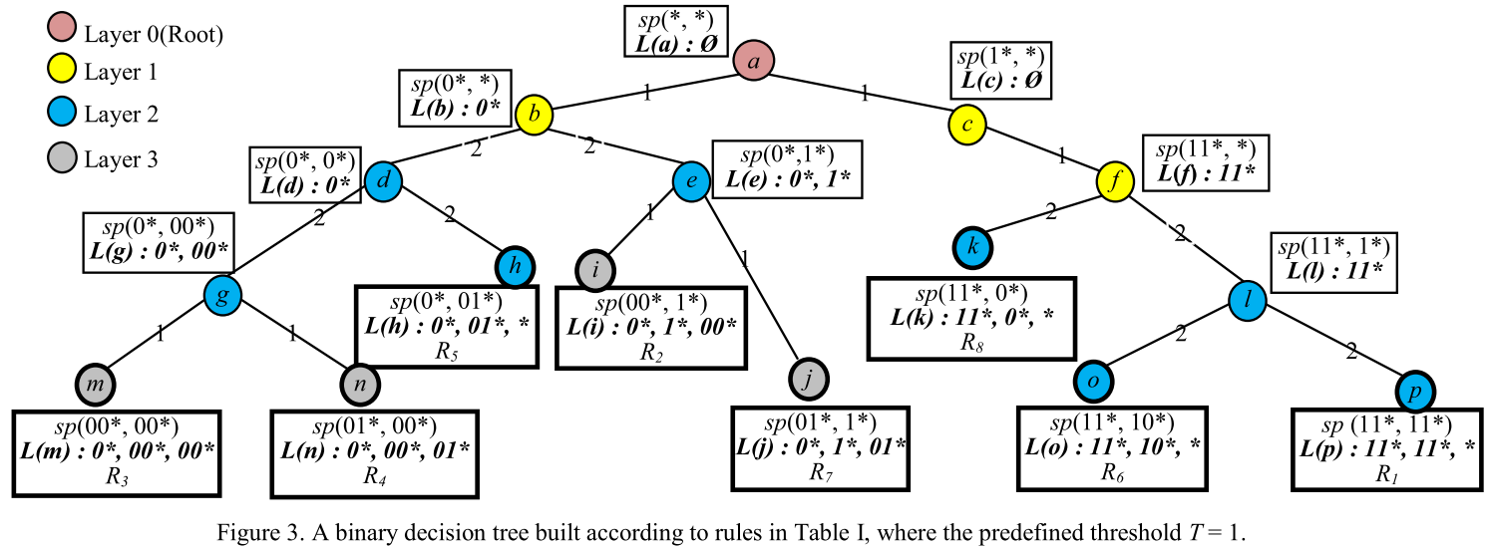
Proposed Scheme

Slide 9
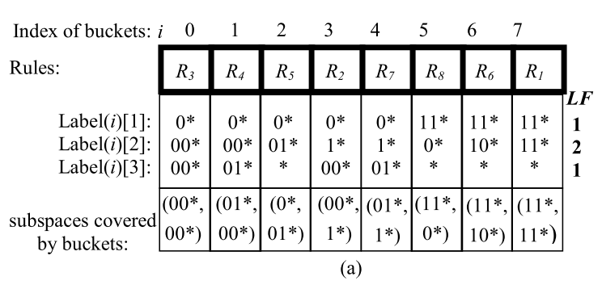
Proposed Scheme
Packet: (00010, 10010)
Notes:
Binary search bucket, linear compare label => level通常很多 => worst case不好

Slide 10
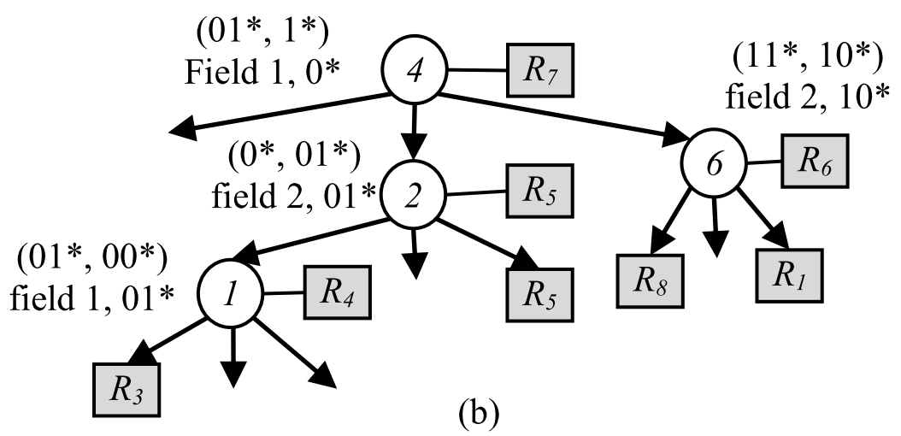
Proposed Scheme
Packet: (00010, 10010)

Slide 11
Hardware Architecture
By our grouping method, we construct the three separable search trees. Each search tree would be mapped to a search engine.
Then, we parallel the search engine and use pipeline technique to increase the throughput.

Slide 12
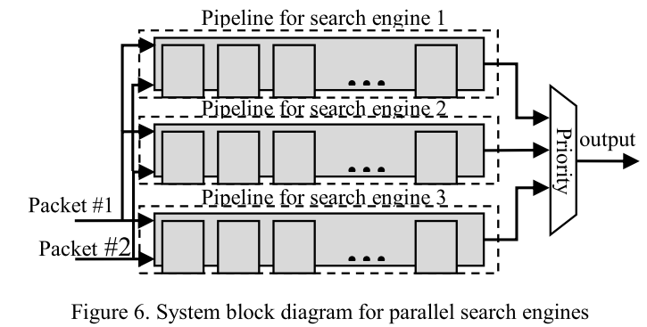
Hardware Architecture

Slide 13
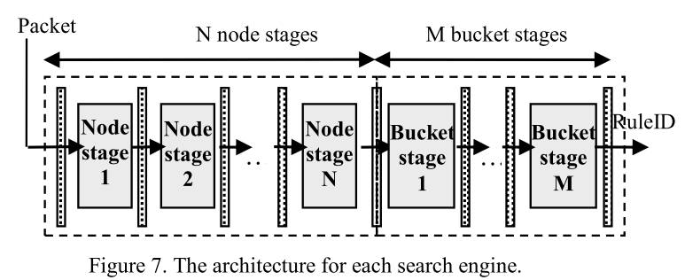
Hardware Architecture
N: height of search tree
M: bucket size

Slide 14
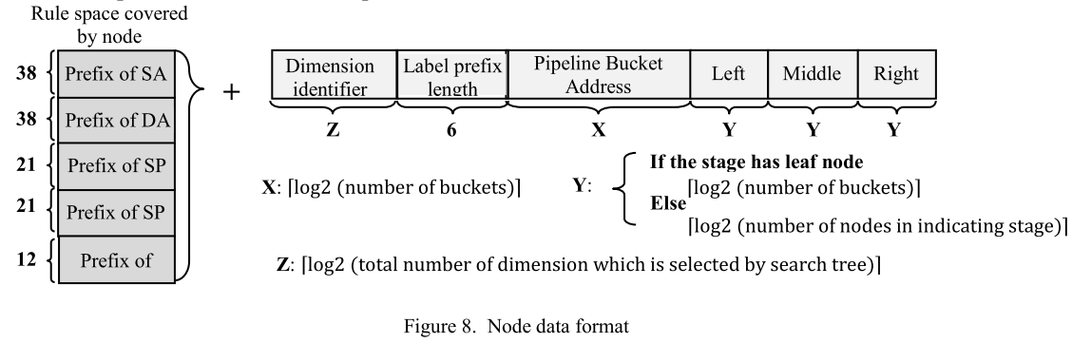
Hardware Architecture

Slide 15
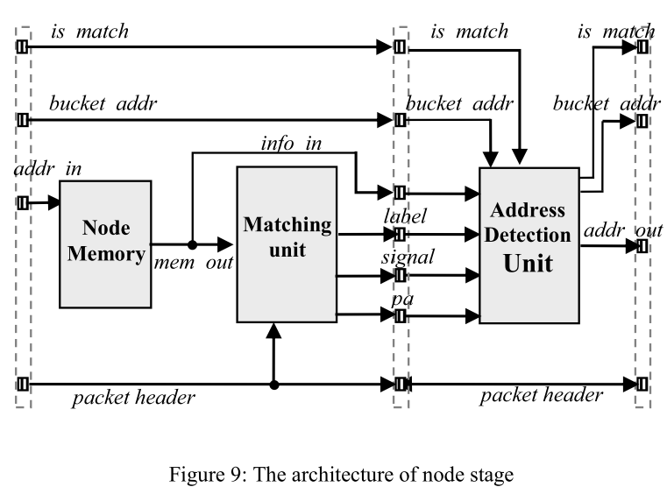
Hardware Architecture
Notes:
為了提高clock rate，將node stage再分成兩個stage，雖然stage數變多，但因為search tree level 並不高所以是可接受的

Slide 16
Hardware Architecture
Bucket Merging
  First, the bucket must sort according to the number of rules.
  The buckets which contain the rule duplication need to be merged first. We can remove the duplication rules from the merging bucket.
  After the bucket merging, we need to sort priority of all the rules for each bucket in decreasing order of the priority.

Slide 17
Hardware Architecture
Bucket Size Increasing
  For each search tree, the number of total stages is not the same. The search engine which contains the less number of stages needs to wait for the one containing more stages.
  A block RAM size is restricted by 1024 entries. If some stages for the smaller search engine contains more than 1024 entries, we maybe can increase the bucket size to
  decrease the number of block RAM usage and the total stages with bucket size increasing is no larger than the largest one.

Slide 18
Hardware Architecture
incoming packet
incoming packet
bucket_addr
bucket_addr
32
38
Prefix Comparator
32
38
Prefix Comparator
16
32
Port Comparator
Bucket Memory
16
32
Port Comparator
8
9
Protocol Comparator
14
RuleID_out
14
1
MUX
RuleID
0
The architecture of bucket stage

Slide 19
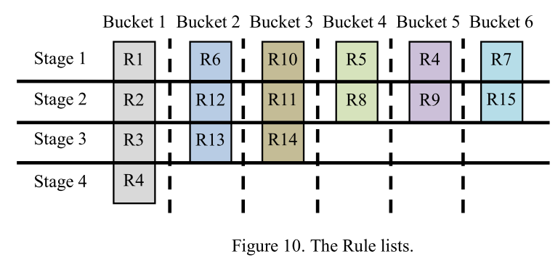
Hardware Architecture

Slide 20
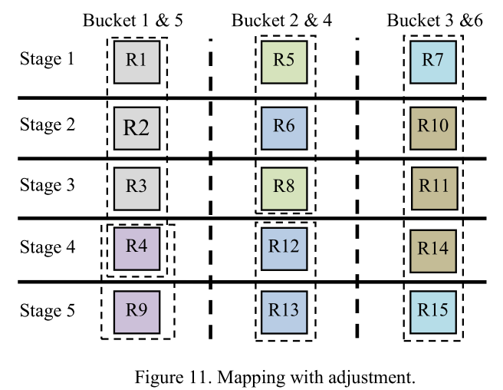
Hardware Architecture

Slide 21
Experimental Results
Three type synthetic classifiers:
  Access Control List (ACL)
  Firewall (FW)
  IP Chain (IPC)
We assume the memory schemes:
  HyperCuts, EffiCuts and LPST, are 22, 22 and 24 bytes, respectively.
We set the bucket size to 16.

Slide 22
Experimental Results
Detailed analysis of proposed scheme
 | ACL1 10K |  |  | FW1 10K |  |  | IPC1 10K
 | Layer | Node | Height | Layer | Node | Height | Layer | Node | Height
Search tree 1 | 7 | 2256 | 12 | 1 | 458 | 9 | 9 | 2007 | 12
Search tree 2 | 8 | 54 | 4 | 1 | 256 | 9 | 8 | 249 | 9
Search tree 3 | 2 | 2 | 2 | 5 | 36 | 5 | 2 | 2 | 2

Slide 23
Experimental Results
Memory usage (Bytes per rules)

Slide 24
Experimental Results
Number of memory accesses in the worst case

Slide 25
Experimental Results
Number of memory accesses in the average case

Slide 26
Experimental Results
The results of hardware simulation implemented in Xilinx 12.2
The target device is Xilinx Virtex-5 XC5VFX200T
Performance Metric
  Slice: The LUT resource in Xilinx FPGA chip
  Block RAMs: The dual-port on-chip memory resource in Xilinx FPGA chip
  Minimum packet size= 40 bytes = 320 bits
  Throughput(Gps) = ( Packet size(bits)*Frequency(MHz) )/1024

Slide 27
Experimental Results
The results of hardware simulation implemented in Xilinx 12.2
The target device is Xilinx Virtex-5 XC5VFX200T
Performance Metric
  Slice: The LUT resource in Xilinx FPGA chip
  Block RAMs: The dual-port on-chip memory resource in Xilinx FPGA chip
  Minimum packet size= 40 bytes = 320 bits
  Throughput(Gps) = ( Packet size(bits)*Frequency(MHz) )/1024

Slide 28
Experimental Results
 |  | ACL1_10K | IPC1_10K | FW1_10K
Engine 0 | Bucket Size | 12 | 13 | 5
 | Tree Memory(KB) | 37.64 | 38.13 | 12.8
 | Bucket Memory(KB) | 181.17 | 212.69 | 63.1
 | Total Memory(KB) | 218.81 | 250.82 | 75.9
Engine 1 | Bucket Size | 7 | 10 | 7
 | Tree Memory(KB) | 1.29 | 7.23 | 11.89
 | Bucket Memory(KB) | 6.63 | 36.55 | 69.73
 | Total Memory(KB) | 7.92 | 43.78 | 81.62
Engine 2 | Bucket Size | 2 | 3 | 7
 | Tree Memory(KB) | 0.017 | 0.19 | 1.84
 | Bucket Memory(KB) | 0.026 | 0.33 | 5.28
 | Total Memory(KB) | 0.043 | 0.52 | 7.12
Total Memory usage(KB) |  | 226.78 | 295.13 | 164.64
# of rules (LST/original) |  | 11098/9603 | 15141/9037 | 9876/9311
Duplication ratio |  | 1.16 | 1.68 | 1.06
# of buckets (merging/original) |  | 964/2768 | 1254/3254 | 1939/2099
Merging ratio |  | 0.65 | 0.61 | 0.08

Slide 29
Experimental Results
The FPGA resources utilization for 10K rule tables (packet size: 40Bytes)
Rule Table | Slices Used/Available (utilization) | Block RAMs Used/ Available (utilization) | Frequency (MHz) | Throughput (Gbps)
ACL1_10K | 898/30720 (3.2%) | 95/456 (20.8%) | 194.64 | 62.28
IPC1_10K | 924/30720 (3.0%) | 121/456 (26.5%) | 192.02 | 61.45
FW1_10K | 827/30720 (2.7%) | 103/456 (22.6%) | 196.95 | 63.05

Slide 30
Experimental Results
The comparison of state-of-the-art FPGA-based packet classification engines with ACL_10K rule table (with dual port memory)
Approaches | Slices Used/Available (utilization) | Block RAMs Used/ Available (utilization) | Throughput (Mpps) | Throughput (Gbps) | Efficiency (Throughput/ Block RAMs)
Our approach | 1796/30720 (6.4%) | 95/456 (20.8%) | 389.28 | 124.57 | 1.311
SPSTwB[21] | 3152/30720 (10.3%) | 182/456 (39.9%) | 415.96 | 129.99 | 0.714
Hyper-Cutting scheme[20] | 7044/30720 (22.9%) | 173/456 (37.9%) | 323.52 | 101.1 | 0.584
SPMT [14] | 6584/30720 (21.4%) | 429/456 (94.1%) | 346.04 | 108.14 | 0.252
BiConOLP [16] | 6611/30720 (21.5%) | 208/456 (45.6%) | 143.4 | 44.81 | 0.215
Two-dimensional Linear Dual-Pipeline [13] | 10307/30720 (33.5%) | 407/456 (89.2%) | 250.8 | 78.37 | 0.192

